Slide 1
Parity Checker
CSE 4205: Digital Logic Design
Aashnan Rahman
Junior Lecturer
Department of Computer Science and Engineering (CSE)
Islamic University of Technology

Slide 2
01
Revisiting a few topics

Slide 3
Topics Covered
NAND and NOR implementation
SoP/Pos – 2 level implementation
XOR and XNOR

Slide 4

NAND Implementation
To facilitate the conversion to NAND logic, it is convenient to define an alternative graphic symbol for the NAND gate.
AND-invert: Consists of an AND gate followed by a small bubble (i.e., complement)
Invert-OR: Consists of an OR gate preceded by a bubble in each input
(i.e., complements each input)
Both of them are equal because of De Morgan's theorem

Slide 5
NAND Implementation
Simplify the function and express it in SOP form
To implement the first level gates, all product terms of the expression (having at least two variables) drawn with NAND gates. Inputs of these NAND gates will be the same literals of the previous terms.
Draw another single NAND gate (representing invert-OR) in the second level with inputs coming from outputs of the first level gates
A term having a single-variable term requires an inverter in the first level. However, if that variable is complemented, it can be connected directly to the input of the second level NAND gate.

Slide 6
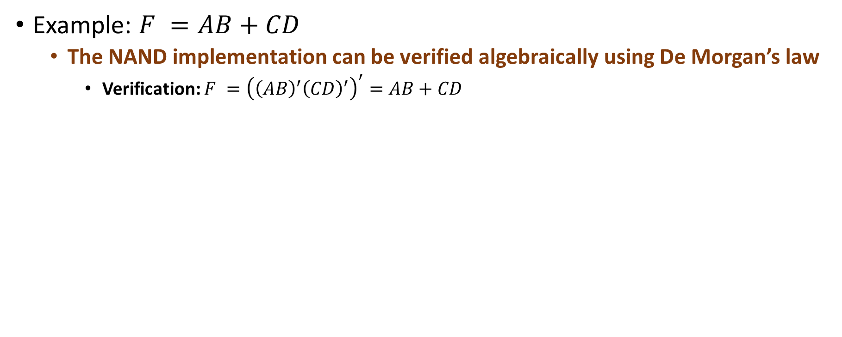
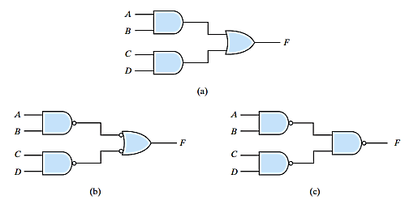
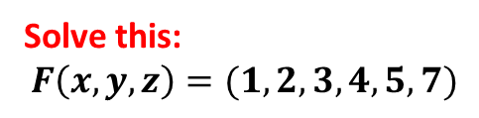
NAND Implementation

Slide 7
NOR Implementation
NOR operation is the dual of NAND operation
All procedures and rules for NOR logic are the dual of the corresponding procedures and rules developed for NAND logic
Another universal gate to implement any logic circuit

Slide 8
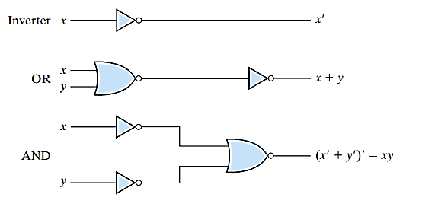
NOR Implementation
To show that any function can be implemented with NOR gate, we need only to show that AND, OR and NOT gates obtained with NOR gates alone
Note: One-input NOR gate behaves exactly like an inverter.

Slide 9
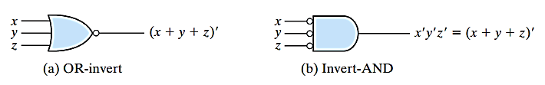
NOR Implementation
To facilitate the conversion to NOR logic, it is convenient to define an alternative graphic symbol for the NOR gate
    OR-invert: Consists of an OR gate followed by a small bubble (i.e., complement)
    Invert-AND: Consists of an AND gate preceded by a bubble in each input
    (i.e., complements each input)
  Both of them are equal because of De Morgan's theorem
  Useful for analysis and design NOR circuits

Slide 10
2 level NOR Implementation
For two level NOR implementation, initially the function must be simplified in POS form
  Note: Simplified POS expression can be obtained by combining all 0s and complementing that expression
    OR gate will be replaced by OR-invert NOR gate in the first level and AND gate will be replaced by invert-AND NOR gate in second level
      As Bubble denotes complementation, two cascaded bubbles will be cancelled by each other
    But, if there is a single-variable term in first level of implementation, an inverter will be required for that term
      We can replace that inverter changing the input variable into its complement (i.e., x will be x’ in the input)

Slide 11
2 level NOR Implementation
Simplify the function and express it in POS form
To implement the first level gates, all sum terms of the expression (having at least two variables) drawn with NOR gates
    Inputs of these NOR gates will be the same literals of the previous terms
Draw another single NOR gate (representing invert-AND) in the second level with inputs coming from outputs of the first level gates
A term having a single variable requires an inverter in the first level. However, if that variable is complemented, it can be connected directly to the input of the second level NOR gate

Slide 12
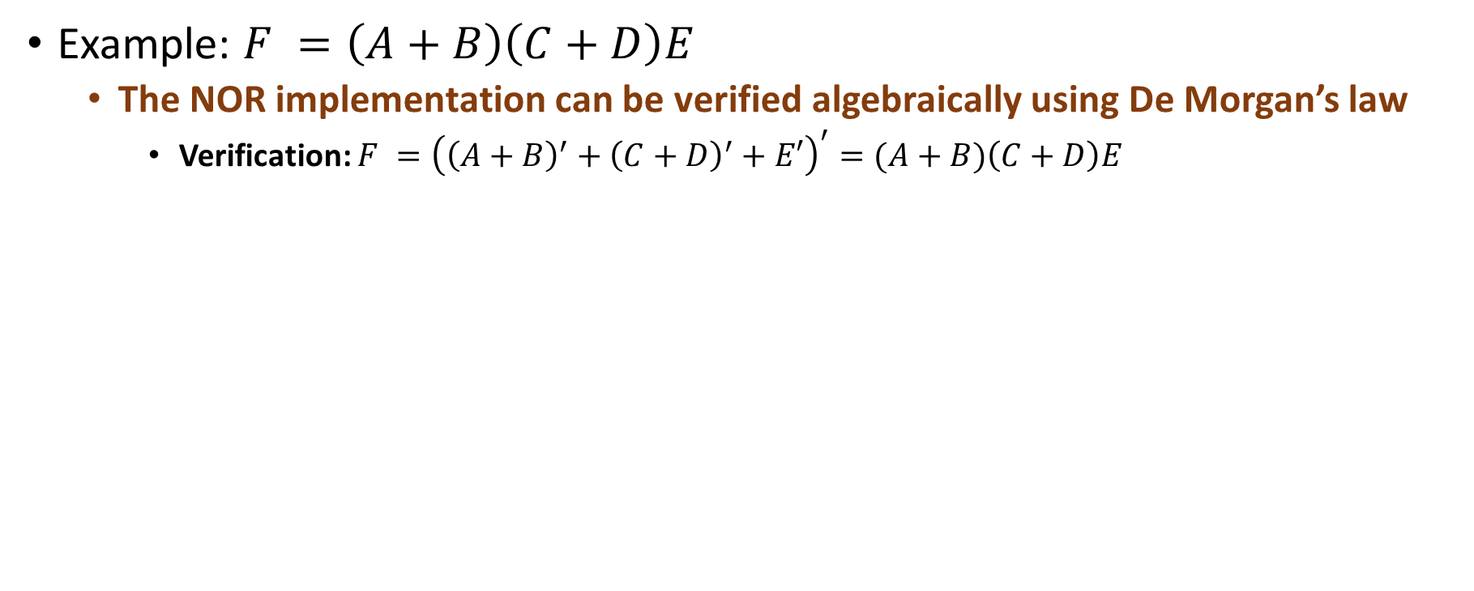
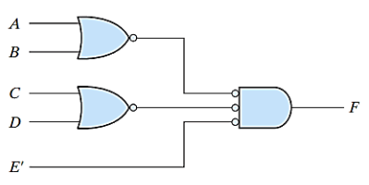
2 level NOR Implementation

Slide 13
Multi Level NAND Implementation
Standard form in SOP or POS expression can be implemented in a two-level implementation
  But sometimes, three or more level getting structure are also observed in digital systems
There are two approaches to design a multi-level NAND circuits:
  Express the Boolean function in terms of AND, OR and NOT operators
  Two alternative ways:
    Approach 1: All the AND, OR and NOT gates would be converted to its corresponding NAND representation
    Approach 2: Convert each AND to AND-invert and each OR to Invert-OR gates
  There should have two cascaded bubbles or inverters who will cancel each other
      Otherwise, one extra inverter should be inserted, or input variables should be complemented

Slide 14
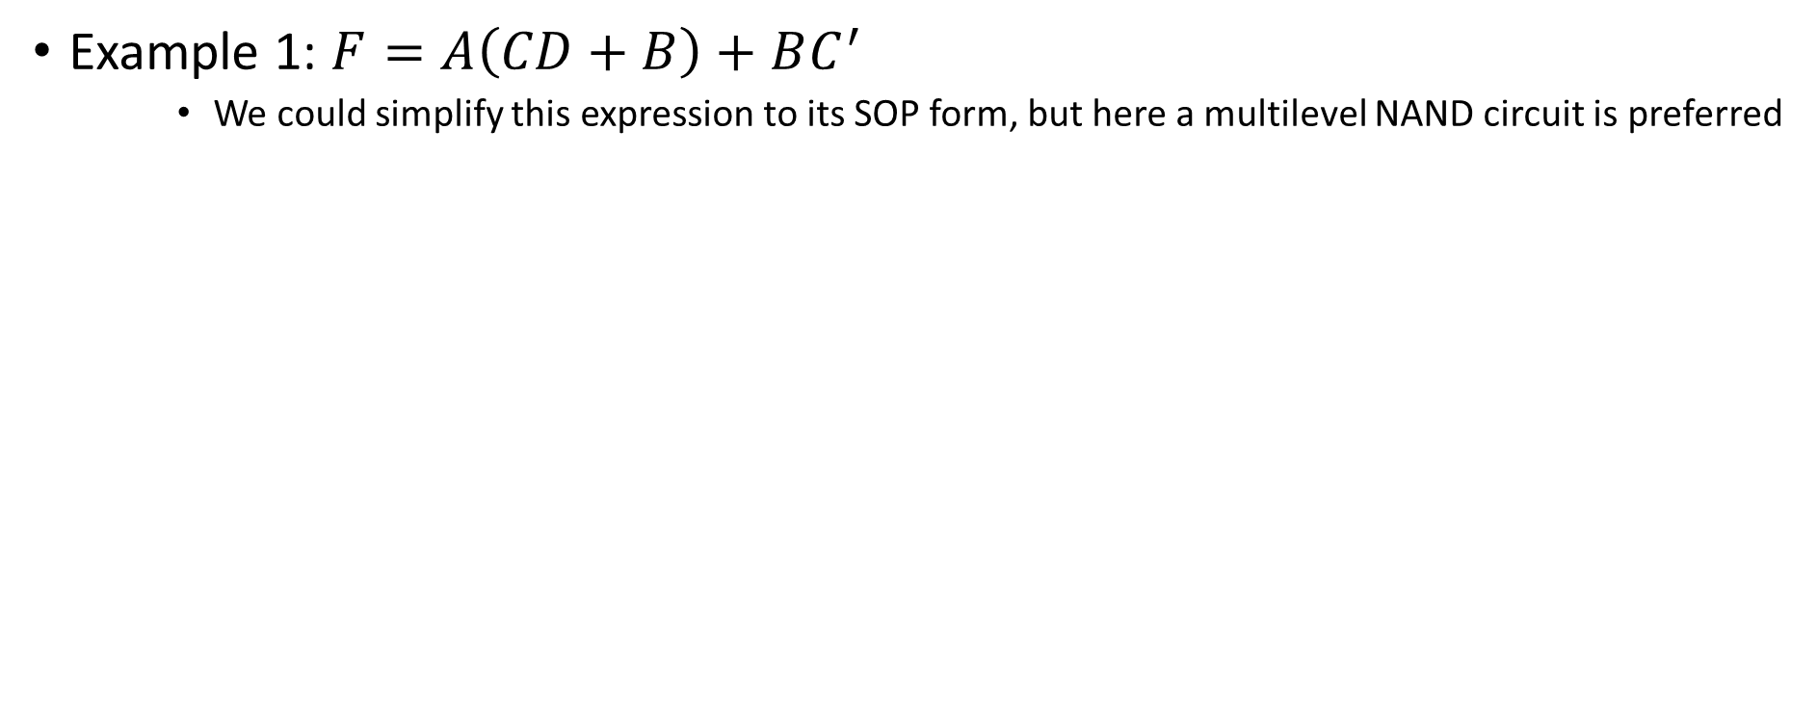
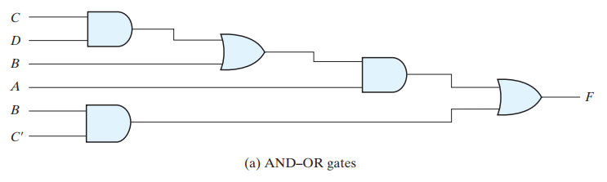
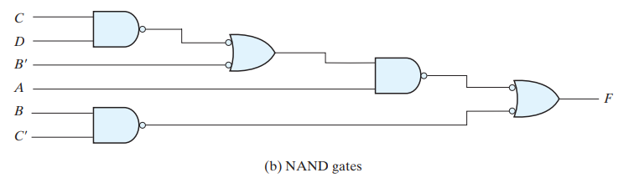
Multi Level NAND Implementation

Slide 15
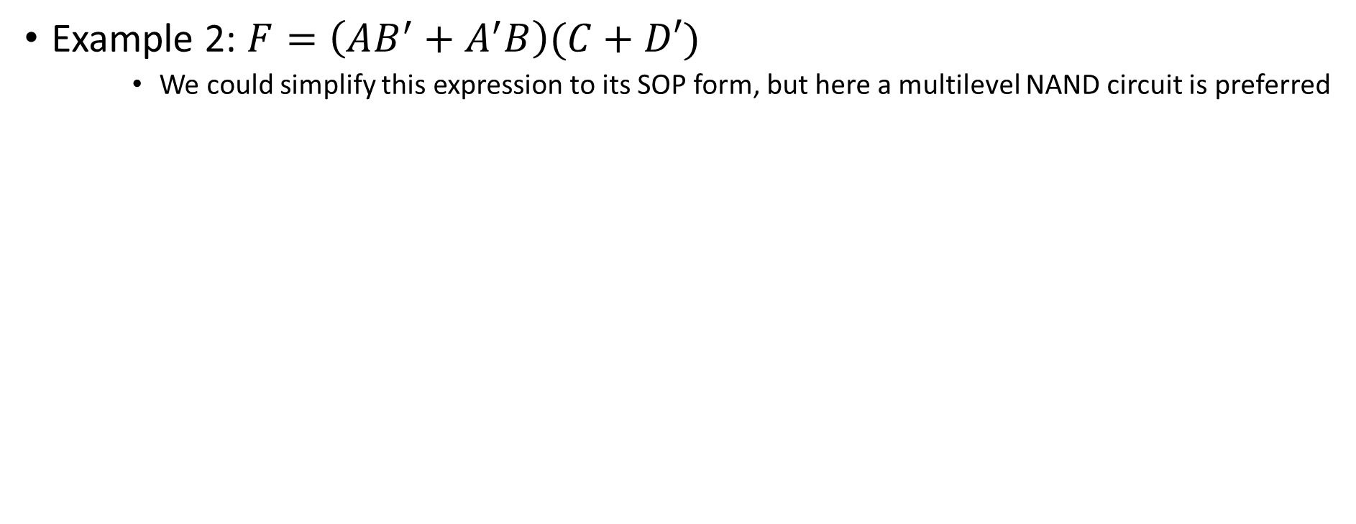
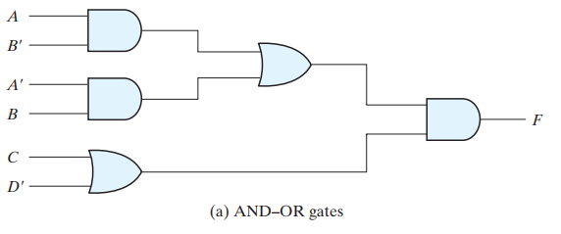
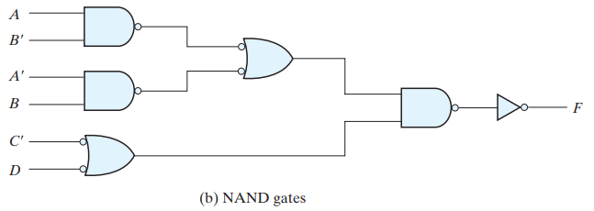
Multi Level NAND Implementation

Slide 16
Multi Level NOR Implementation
There are two approaches to design a multi level NOR circuits:
  Express the Boolean function in terms of AND, OR and NOT operators
  Two alternative ways:
    Approach 1: All the AND, OR and NOT gates would be converted to its corresponding NOR representation
    Approach 2: Convert each AND to invert-AND and each OR to OR-invert gates
  There should have two cascaded bubbles or inverters who will cancel each other
      Otherwise, one extra inverter should be inserted, or input variables should be complemented

Slide 17
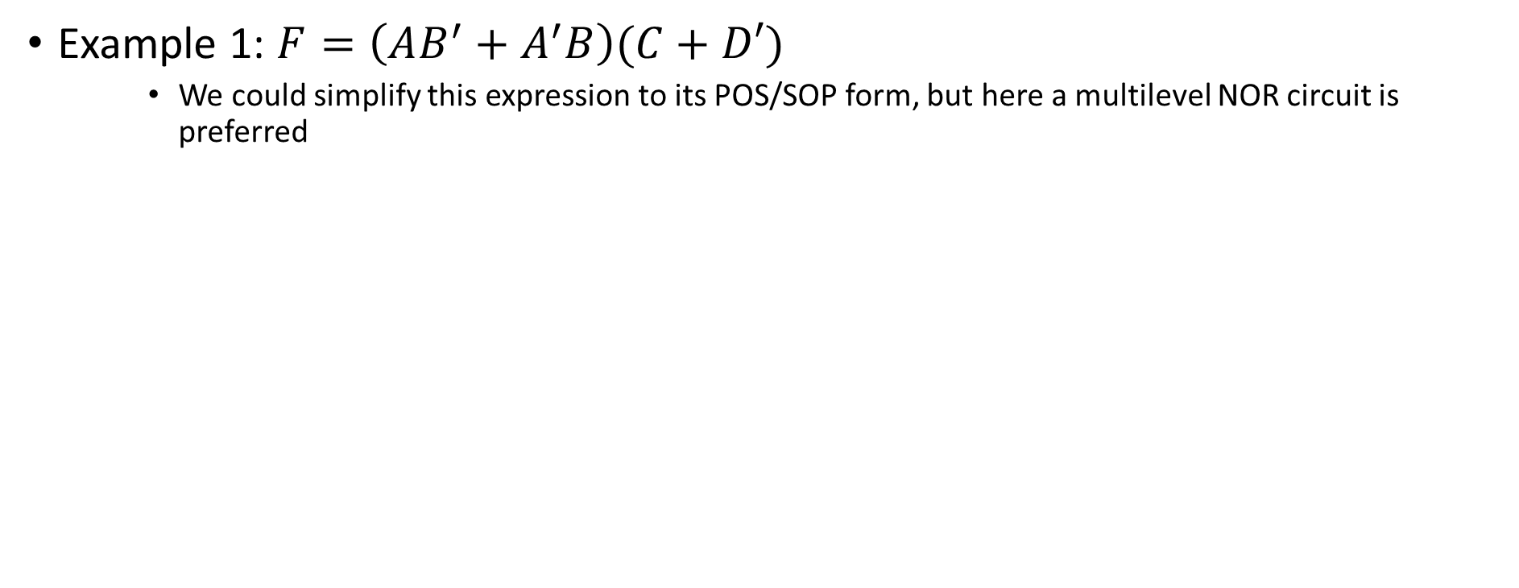
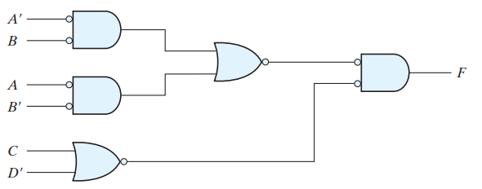
Multi Level NOR Implementation

Slide 18
02
XOR and XNOR

Slide 19
Usage of XOR and XNOR
Only a limited number of Boolean functions can be expressed with XOR and XNOR gates
In some digital system designs, they could be used
  Specially, they are useful in -
    Arithmetic operations (e.g., add, subtract, etc.)
    Logical operation (e.g., complement)
    Error detection and correction (e.g., parity generator and checker)
    Gray code conversion
XOR gate is used extensively, XNOR could be implemented as XOR-inverter.

Slide 20
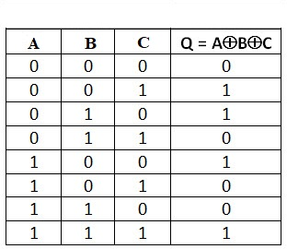
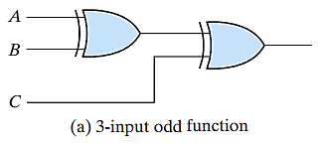

Odd Function
Basically, two input XOR gate could be defined as difference function
  But, if we increase the number of input to three or more, definition will be changed
    Example:
  Here, three input XOR gate produces 1 if only one variable is 1 or all three variables are 1
Definition: A multiple input XOR gate operates as an odd function i.e. an odd number of inputs should be 1.
    An n–variable XOR function is an odd function defined as the logical sum of the 2^{n}/2 minterms whose binary numerical values have an odd number of 1s

Slide 21
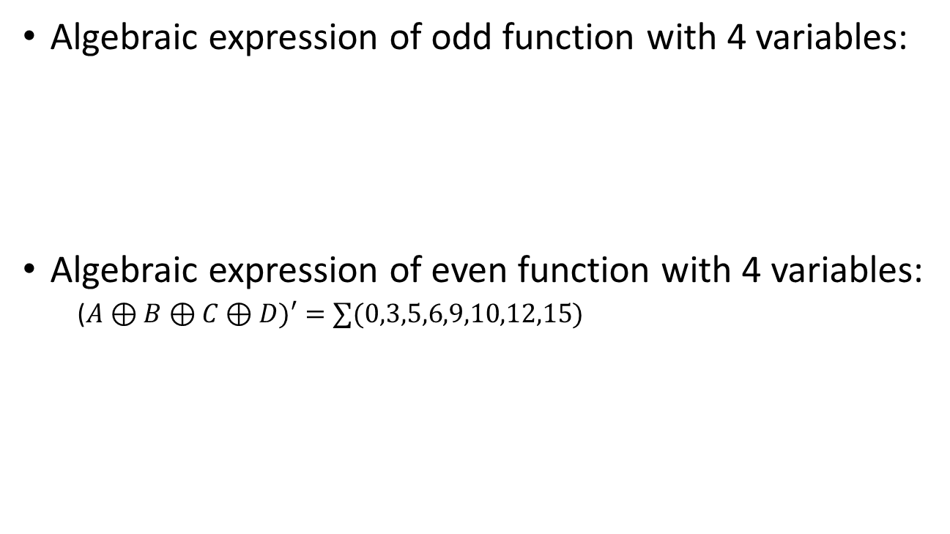
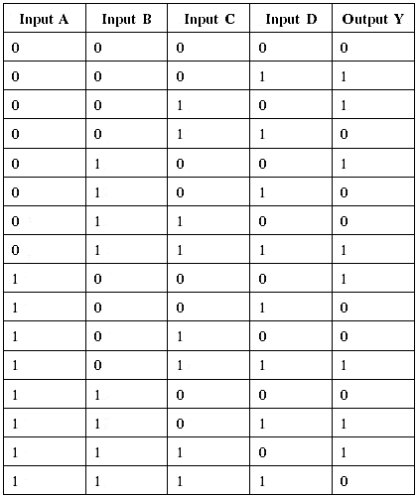
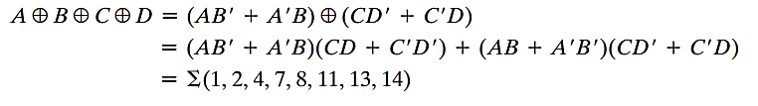
Odd and Even Function

Slide 22
03
Parity Checker

Slide 23
Parity Generator and Checker
XOR function is very useful for error detection and correction codes
Parity bit is an extra bit which is usually included with original message during transmission for error detection
  Parity Generator – the circuit that generates the parity bit in the transmitter
  Parity Checker – the circuit that checks the parity in the receiver
Example:
  Consider a three bit message (e.g. x, y, z) to be transmitted together with an even parity bit (e.g. P)

Slide 24
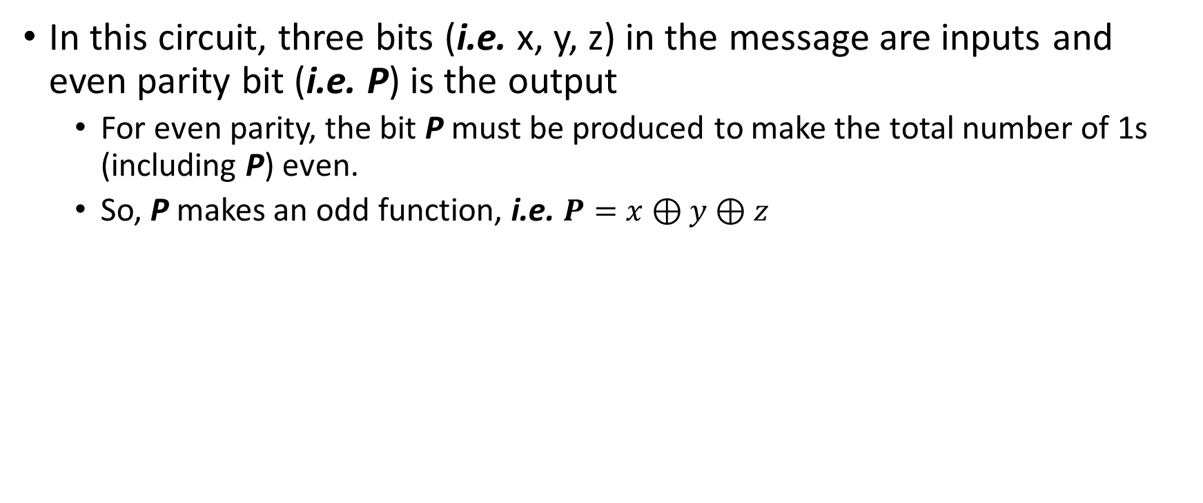
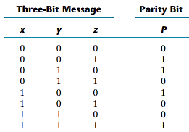
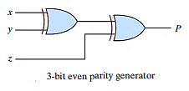
Parity Generator and Checker

Slide 25
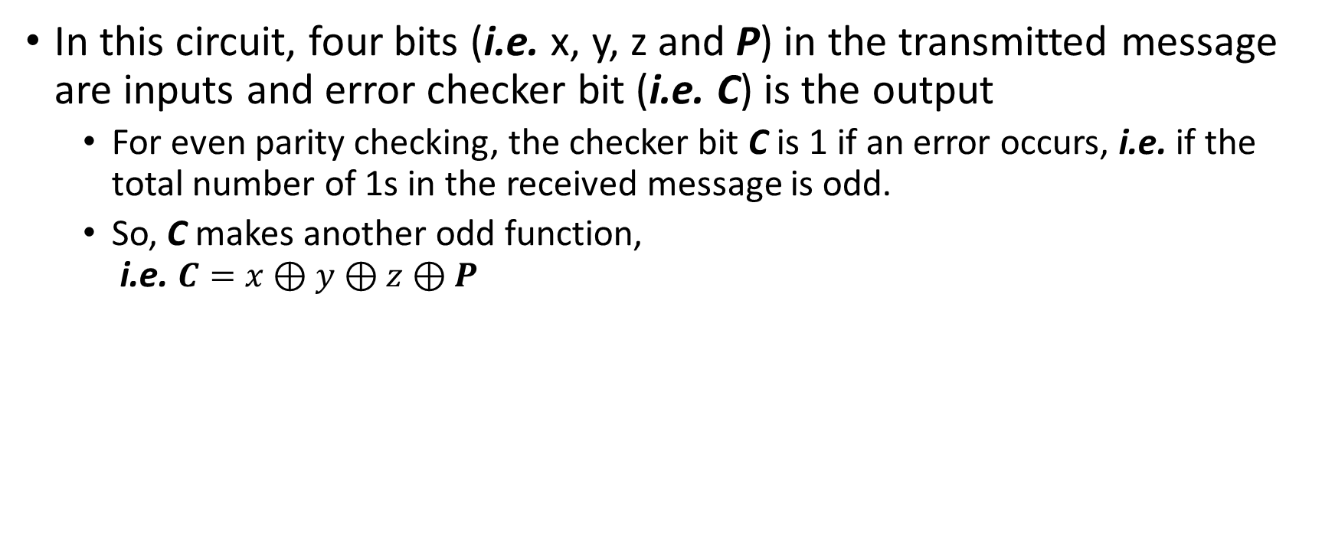
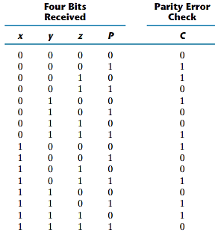
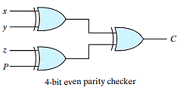
Parity Generator and Checker

Slide 26
Thank You !!
Feel free to ask any questions

